Slide 1
ISLR Chapter 7.1-3 Moving Beyond Linearity
Reviewed by: Kezhen Fei
2/13/2014

Slide 2
Why ?
Standard linear regression can have significant limitations of predictive power
When
Linearity assumption is not met

Slide 3
Extensions of linear models
Simple extensions:
Polynomial regression
Step function
More sophisticated ones:
Regression splines
Smoothing splines
Local regression
Generalized additive models

Slide 4
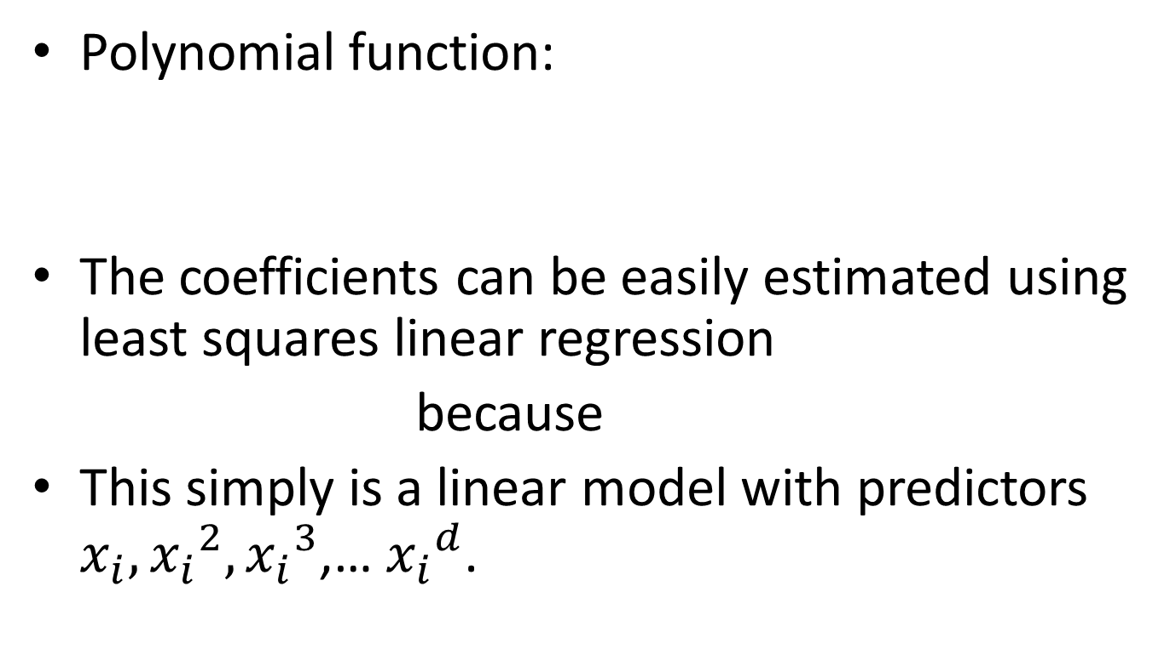
7.1 Polynomial Regression
Polynomial function:
The coefficients can be easily estimated using least squares linear regression
because
This simply is a linear model with predictors $x_{i}, {x_{i}}_{}^{2},{x_{i}}_{}^{3}$,… ${x_{i}}_{}^{d}$.

Slide 5
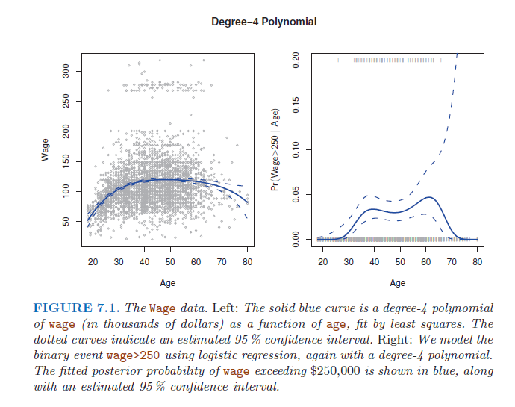

Slide 6
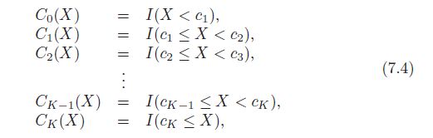
7.2 Step Functions
X is broken down into bins , and a different constant is fit in each bin.
Basically create a set of dummy variables

Slide 7
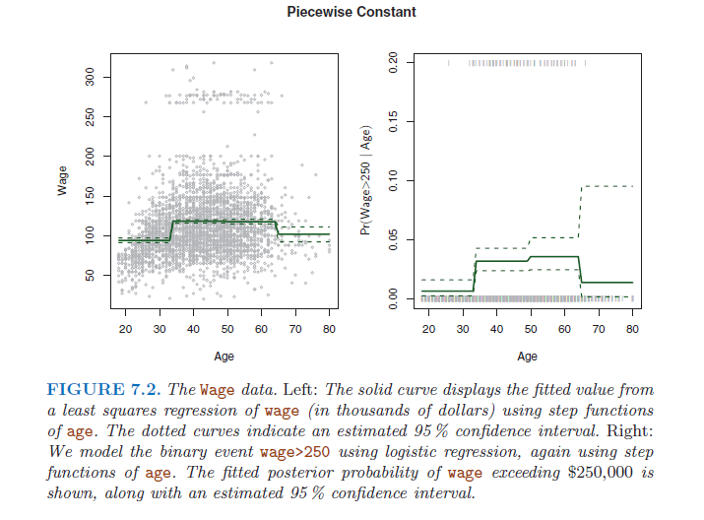

Slide 8
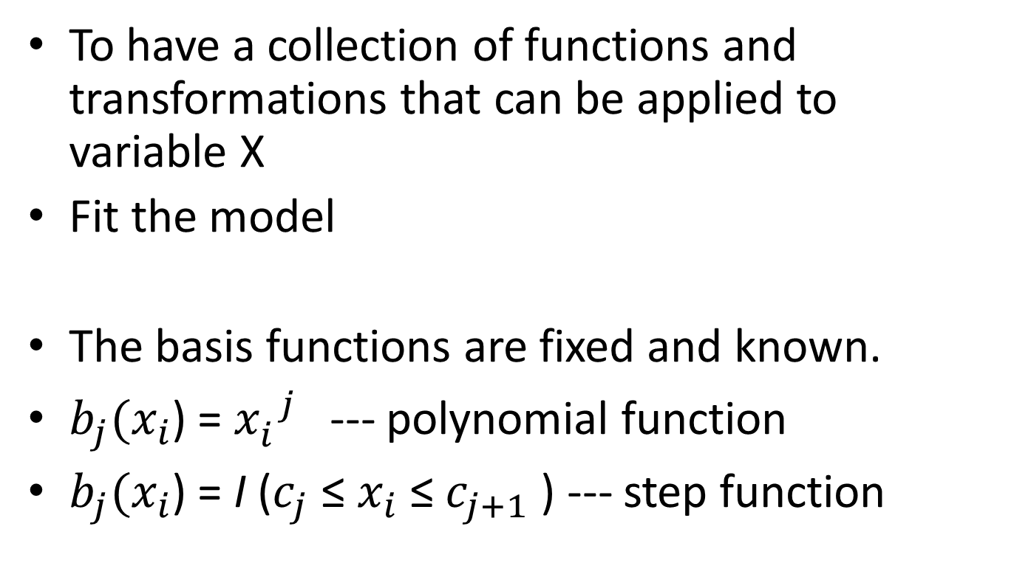
7.3 Basis Functions
To have a collection of functions and transformations that can be applied to variable X
Fit the model
The basis functions are fixed and known.
$b_{j}(x_{i}$) = ${x_{i}^{}}_{}^{j}$ --- polynomial function
$b_{j}(x_{i}$) = I ($c_{j}$ ≤ $x_{i}$ ≤ $c_{j+1}$ ) --- step function

